Slide 1
Prioritize
Joel Wilhelm Cody Jones Wajahat Iqbal Shahrukh Rehman

Slide 2
Project Goals
Create a useful mobile application to assist others.
Develop a strategy for reminding users of their tasks at a timely basis.
Learn a new platform for programming.
Learn the process of mobile application development.

Slide 3
Project Requirements
Prioritize must:
- Be simple, easy to use, quick to understand.
- Remind the user of their event at an appropriate time
- Be able to save, load, edit, and delete reminder information
- Be able to sync to other devices the user owns

Slide 4
Overall System
(Android App)
Android App
Google Drive
Android App
SQLite Database
UI
JSON Parser
Reminder Creation / Priority Algorithm
Google Drive
Notification
JSON String

Slide 5
Priority Algorithm
General premise: The priority value is an integer that ranges from 1 - 5 (low priority to high priority). Each level of priority offers a shorter interval in which to alert the user.
Mathematical Representation:
Current Date + Current Time + Due Date + Due Time + Priority Value = Calculated Remind Date + Calculated Remind Time
Android App
SQLite Database
UI
Notification
UI
JSON Parser
Reminder Creation / Priority Algorithm
SQLite Database
Priority Algorithm
JSON
Google Drive
Notification
JSON String

Slide 6
Priority Strategy
Alert for deadline in exactly 14 days
Priority Value | Initial Alert Date and Time
1 | Alert in 13.5 days.
2 | Alert in 11 days.
3 | Alert in 9.5 days.
4 | Alert in 6 days.
5 | Alert in 4 days.
Android App
SQLite Database
UI
Notification
UI
JSON Parser
Reminder Creation / Priority Algorithm
SQLite Database
Priority Algorithm
JSON
Google Drive
Notification
JSON String

Slide 7
Priority Strategy
Alert for deadline in exactly 14 days
Priority Value | Initial Alert Date and Time
1 | Alert in 13.5 days.
2 | Alert in 11 days.
3 | Alert in 9.5 days.
4 | Alert in 6 days.
5 | Alert in 4 days.
Android App
SQLite Database
UI
Notification
UI
JSON Parser
Reminder Creation / Priority Algorithm
SQLite Database
Priority Algorithm
JSON
Google Drive
Notification
JSON String

Slide 8
Priority Strategy
Priority value of 4
Deadline in exactly two weeks
Initial Alert
Alert in 6 days
Second Alert
Alert in 10 days
Third Alert
Alert in 12 days
Fourth Alert
Alert in 13 days

Slide 9
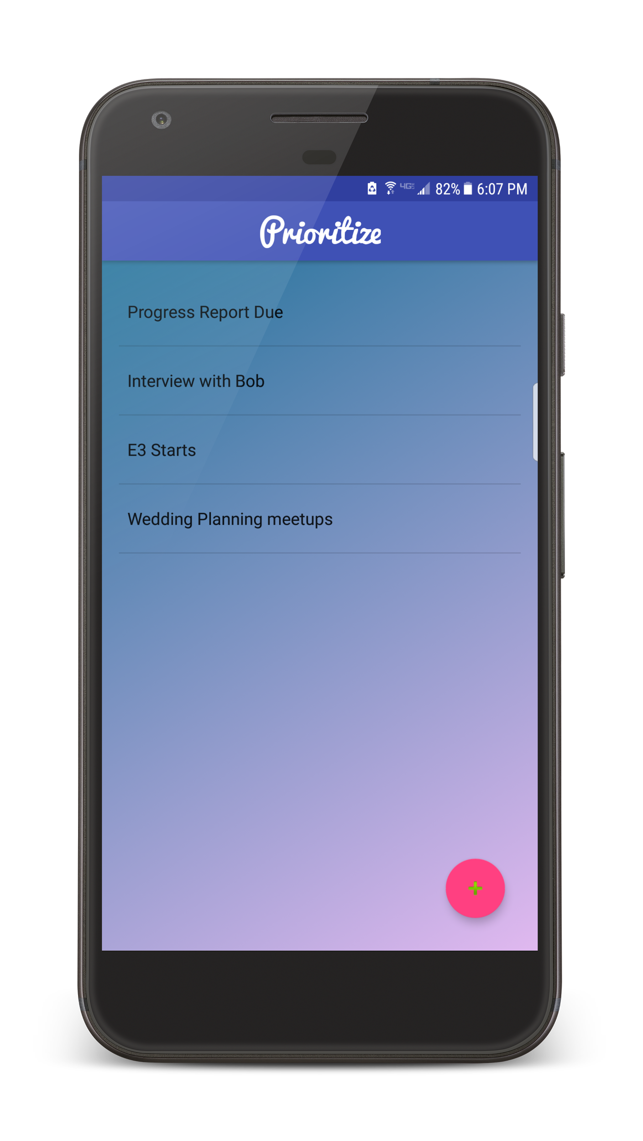
User Interface
List of Reminders will be shown here
Android App
SQLite Database
UI
Notification
UI
JSON Parser
Reminder Creation / Priority Algorithm
SQLite Database
Priority Algorithm
JSON
Google Drive
Notification
JSON String

Slide 10
User Interface
Add a Reminder Button
Android App
SQLite Database
UI
Notification
UI
JSON Parser
Reminder Creation / Priority Algorithm
SQLite Database
Priority Algorithm
Google Drive
Notification
JSON
JSON String

Slide 11
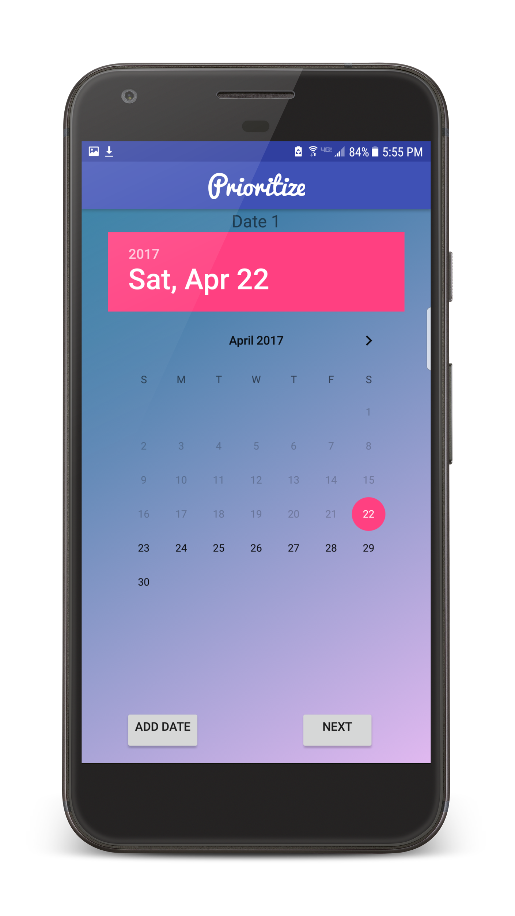
User Interface
Allows you to select the date your Reminder is due
Android App
SQLite Database
UI
Notification
UI
JSON Parser
Reminder Creation / Priority Algorithm
SQLite Database
Priority Algorithm
JSON
Google Drive
Notification
JSON String

Slide 12
User Interface
Add an additional date, or move to the next part.
Android App
SQLite Database
UI
Notification
UI
JSON Parser
Reminder Creation / Priority Algorithm
SQLite Database
Priority Algorithm
JSON
Google Drive
Notification
JSON String

Slide 13
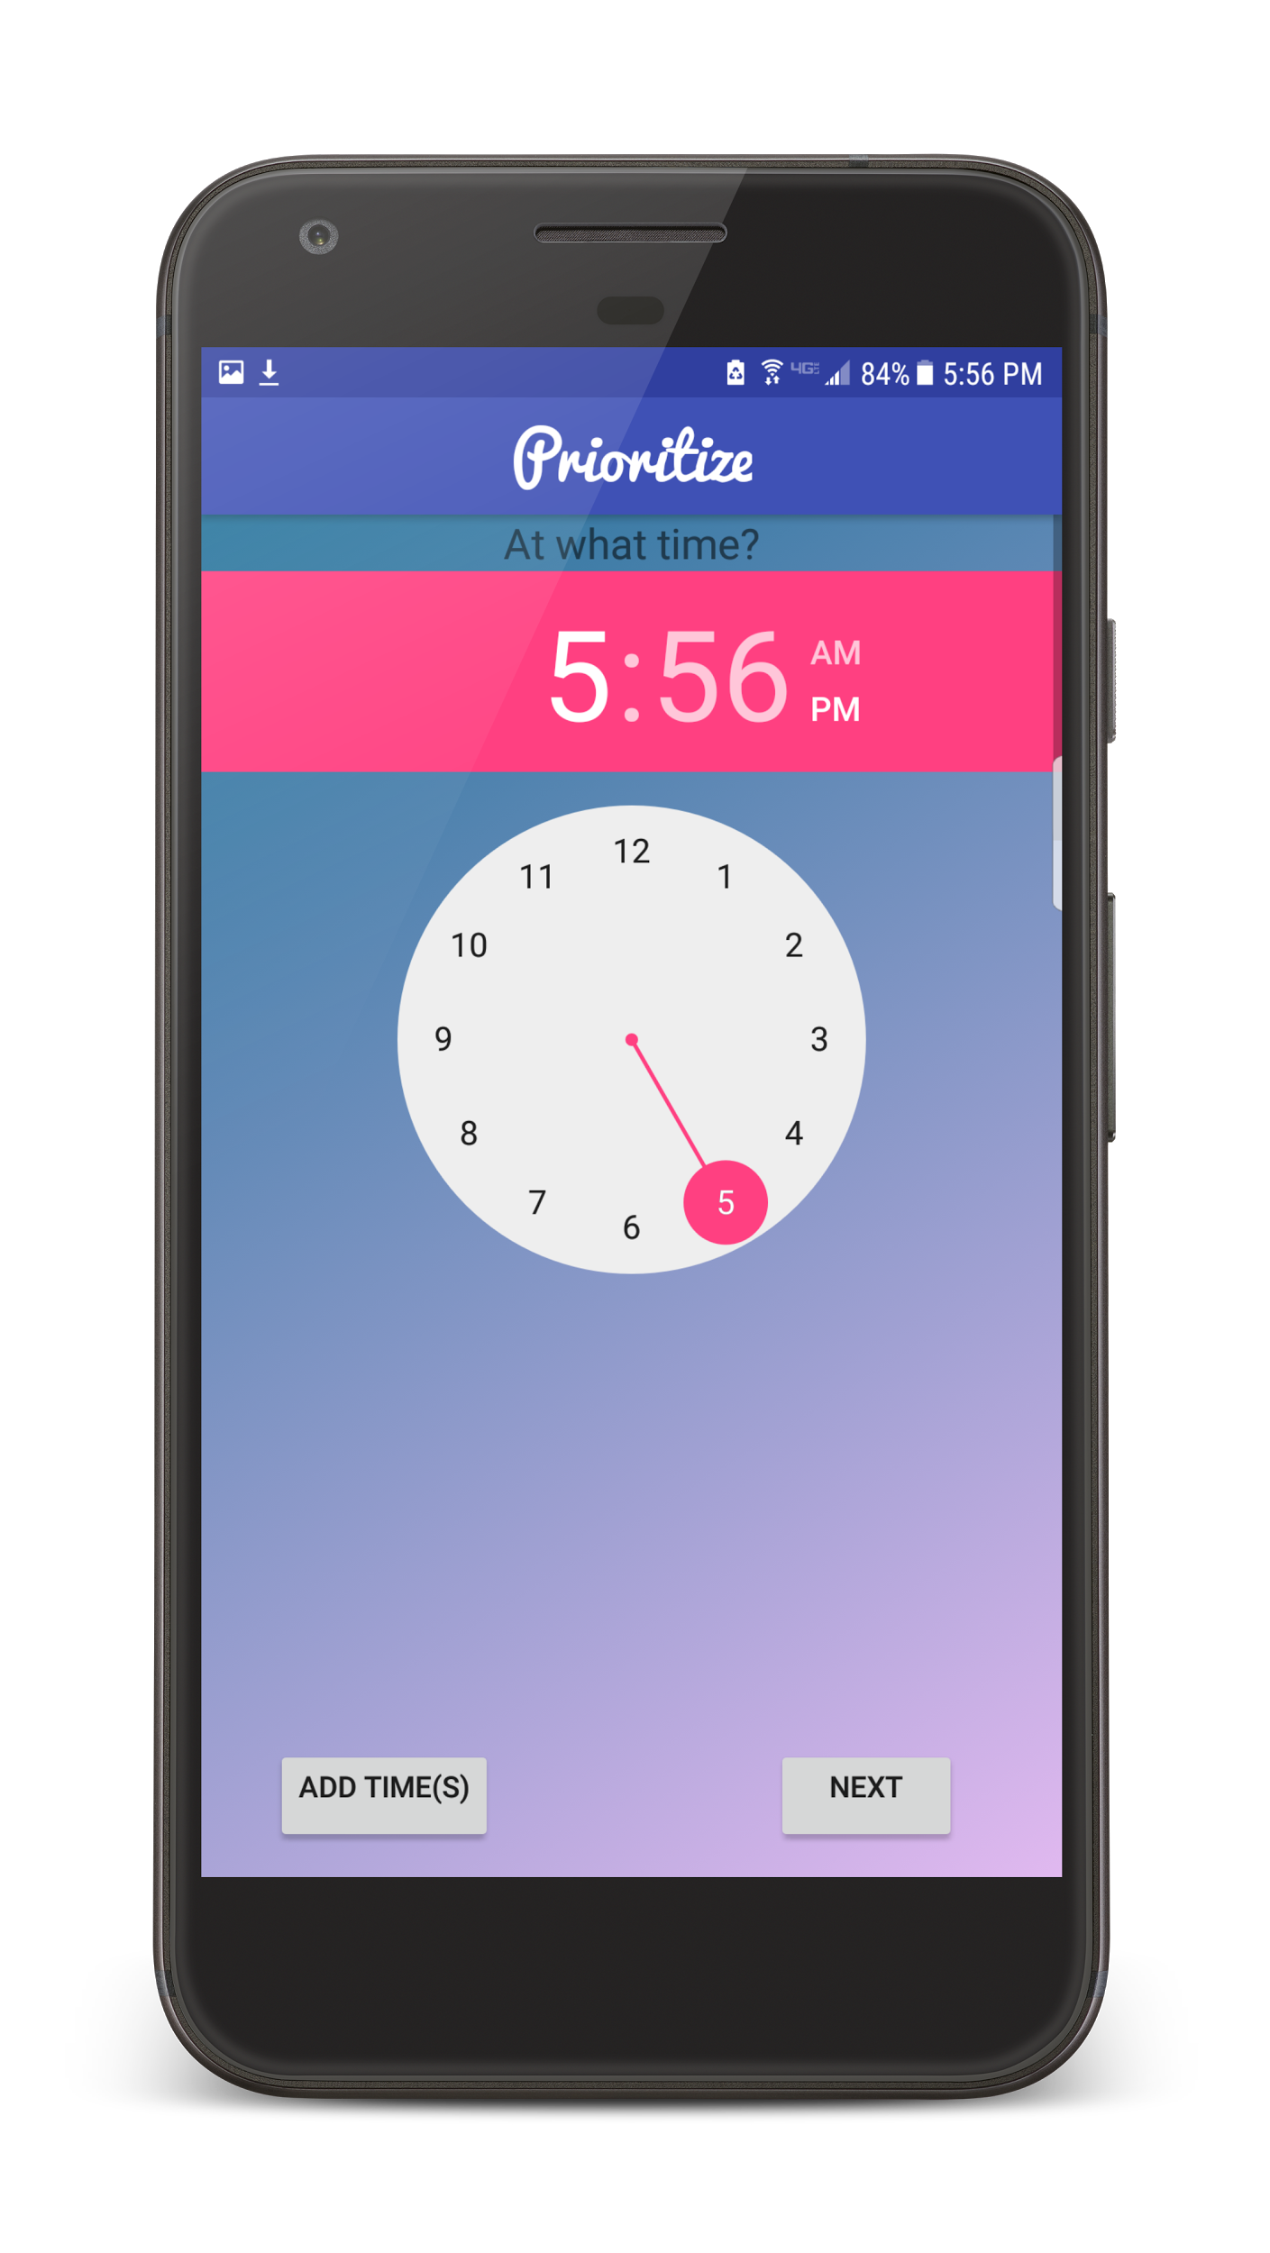
User Interface
Select the Time the reminder is due
Android App
SQLite Database
UI
Notification
UI
JSON Parser
Reminder Creation / Priority Algorithm
SQLite Database
Priority Algorithm
JSON
Google Drive
Notification
JSON String

Slide 14
User Interface
Add an additional time, or move to the next part.
Android App
SQLite Database
UI
Notification
UI
JSON Parser
Reminder Creation / Priority Algorithm
SQLite Database
Priority Algorithm
JSON
Google Drive
Notification
JSON String

Slide 15
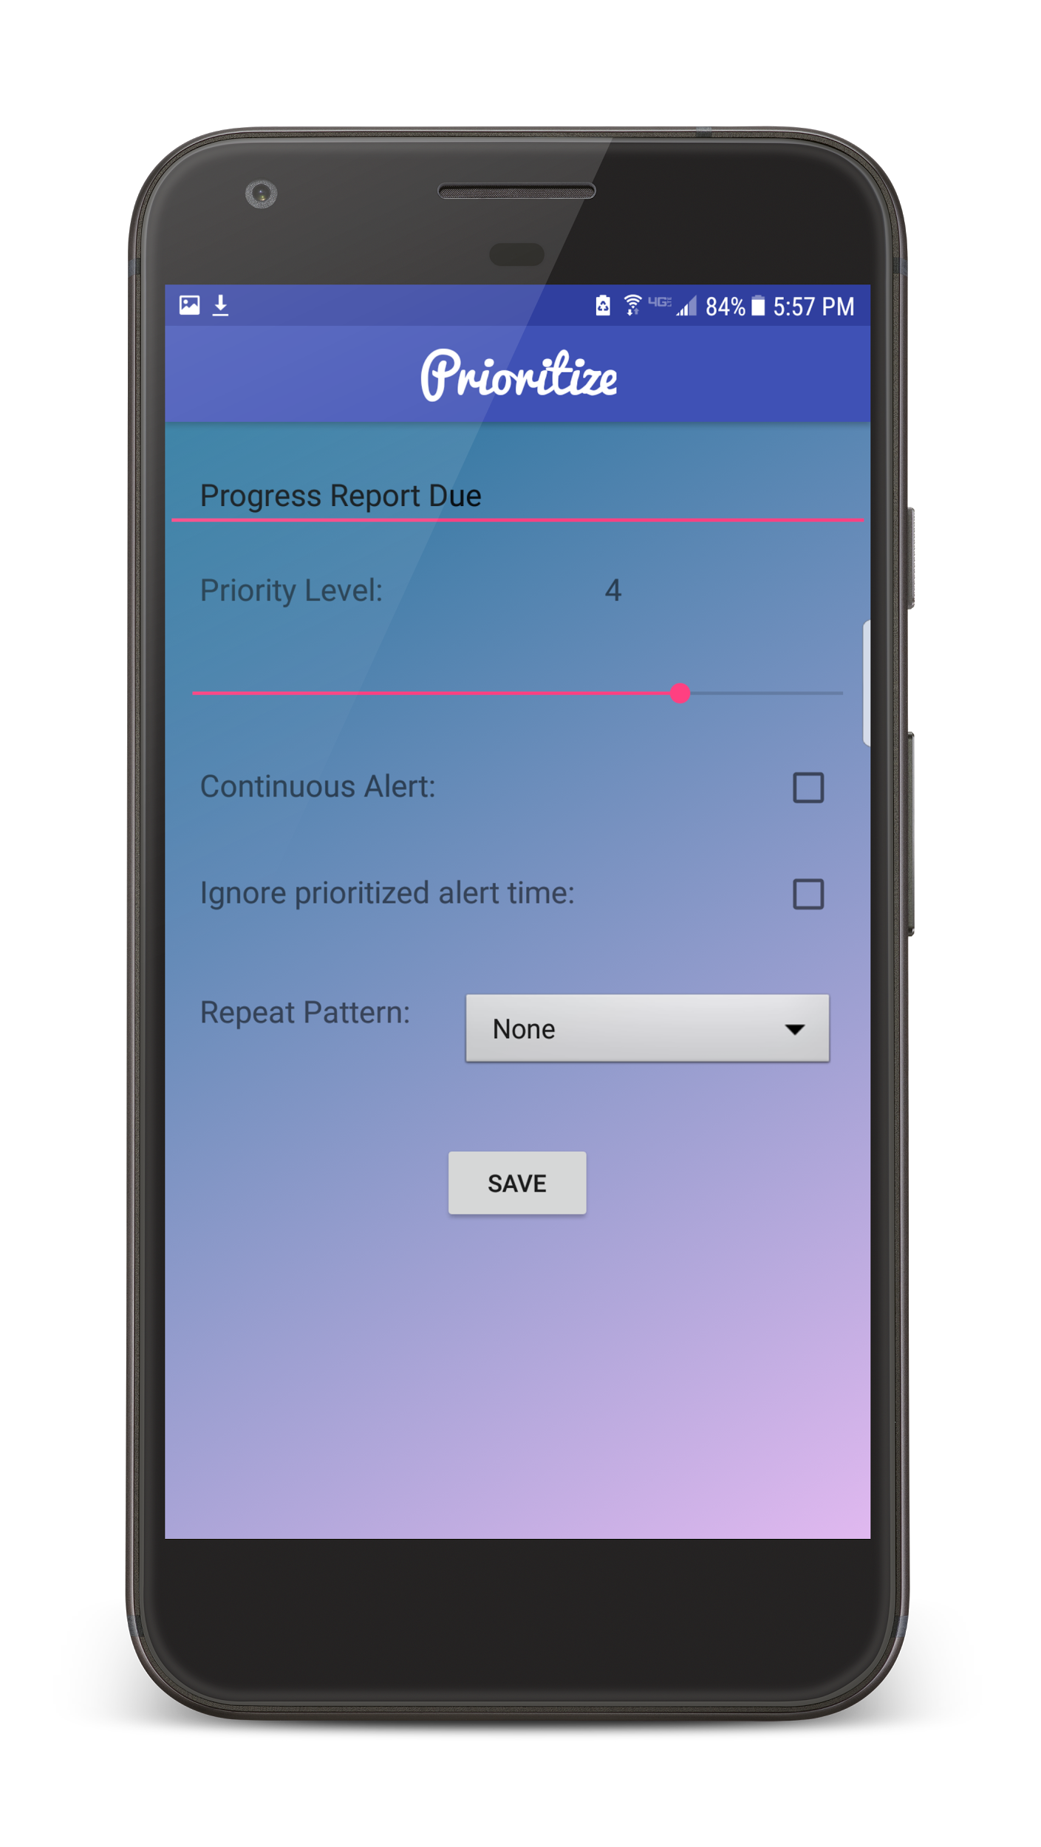
User Interface
Enter Description of your Event here
Android App
SQLite Database
UI
Notification
UI
JSON Parser
Reminder Creation / Priority Algorithm
SQLite Database
Priority Algorithm
JSON
Google Drive
Notification
JSON String

Slide 16
User Interface
Slide the bar to select Priority Level
Android App
SQLite Database
UI
Notification
UI
JSON Parser
Reminder Creation / Priority Algorithm
SQLite Database
Priority Algorithm
JSON
Google Drive
Notification
JSON String

Slide 17
User Interface
Check these boxes for other options - Needing user to turn off alarm / set alarm off at designated time, ignoring Priority
Android App
SQLite Database
UI
Notification
UI
JSON Parser
Reminder Creation / Priority Algorithm
SQLite Database
Priority Algorithm
JSON
Google Drive
Notification
JSON String

Slide 18
User Interface
Repeat Pattern Designation
Android App
SQLite Database
UI
Notification
UI
JSON Parser
Reminder Creation / Priority Algorithm
SQLite Database
Priority Algorithm
JSON
Google Drive
Notification
JSON String

Slide 19
User Interface
Save the Reminder!
Android App
SQLite Database
UI
Notification
UI
JSON Parser
Reminder Creation / Priority Algorithm
SQLite Database
Priority Algorithm
JSON
Google Drive
Notification
JSON String

Slide 20
User Interface
Edit a Reminder with a touch
Android App
SQLite Database
UI
Notification
UI
JSON Parser
Reminder Creation / Priority Algorithm
SQLite Database
Priority Algorithm
JSON
Google Drive
Notification
JSON String

Slide 21
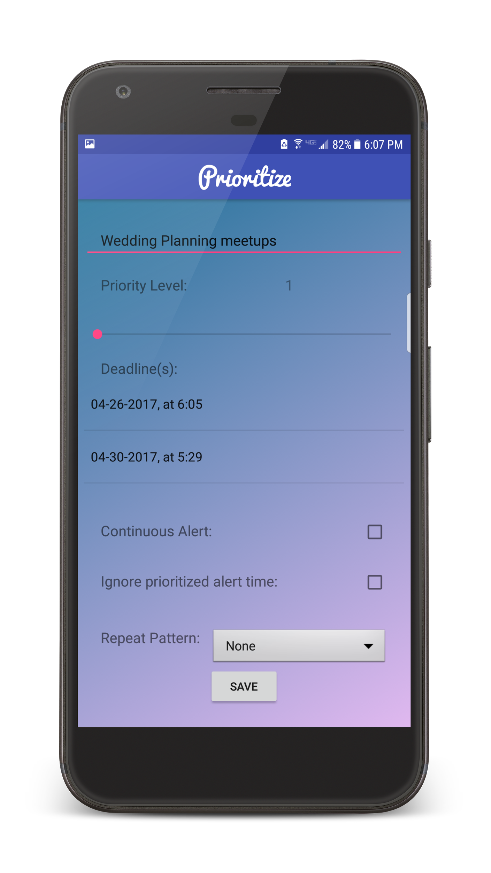
User Interface
You can edit all designated options.
Android App
SQLite Database
UI
Notification
UI
JSON Parser
Reminder Creation / Priority Algorithm
SQLite Database
Priority Algorithm
JSON
Google Drive
Notification
JSON String

Slide 22
SQLite Database
Database structure for holding Reminder information.
Each Reminder is stored as a single table titled, Reminder.
Android App
SQLite Database
UI
Notification
UI
JSON Parser
Reminder Creation / Priority Algorithm
SQLite Database
Priority Algorithm
JSON
Google Drive
Notification
JSON String

Slide 23
SQLite Database
Columns
Reminder Description (String)
Priority Value (int)
AlarmManager ID (int)
Repeat Pattern (int)
Alarm (int)
On Time (int)
Due Dates 1 - 7 (String)
Due Times 1 - 7 (String)
Number of Dates (int)
Current Date (int)
Alert Date (String)
Alert Time (String)
Android App
SQLite Database
UI
Notification
UI
JSON Parser
Reminder Creation / Priority Algorithm
SQLite Database
Priority Algorithm
JSON
Google Drive
Notification
JSON String

Slide 24
JSON
Data interchange format for syncing Reminders across devices.
Reminder information is stored in a JSON string in the user’s Google Drive Application Data Folder.
New devices will use the JSON parser to construct a JSON object from the JSON String, and load the fields into the corresponding SQLite columns.
Android App
SQLite Database
UI
Notification
UI
JSON Parser
Reminder Creation / Priority Algorithm
SQLite Database
Priority Algorithm
JSON
Google Drive
Notification
JSON String

Slide 25
Notifications
Two types of Notifications:
Alerts: A simple tone, letting the user know of their Reminder
Alarm: Rings until user interaction.
Android App
SQLite Database
UI
Notification
UI
JSON Parser
Reminder Creation / Priority Algorithm
SQLite Database
Priority Algorithm
JSON
Google Drive
Notification
JSON String

Slide 26
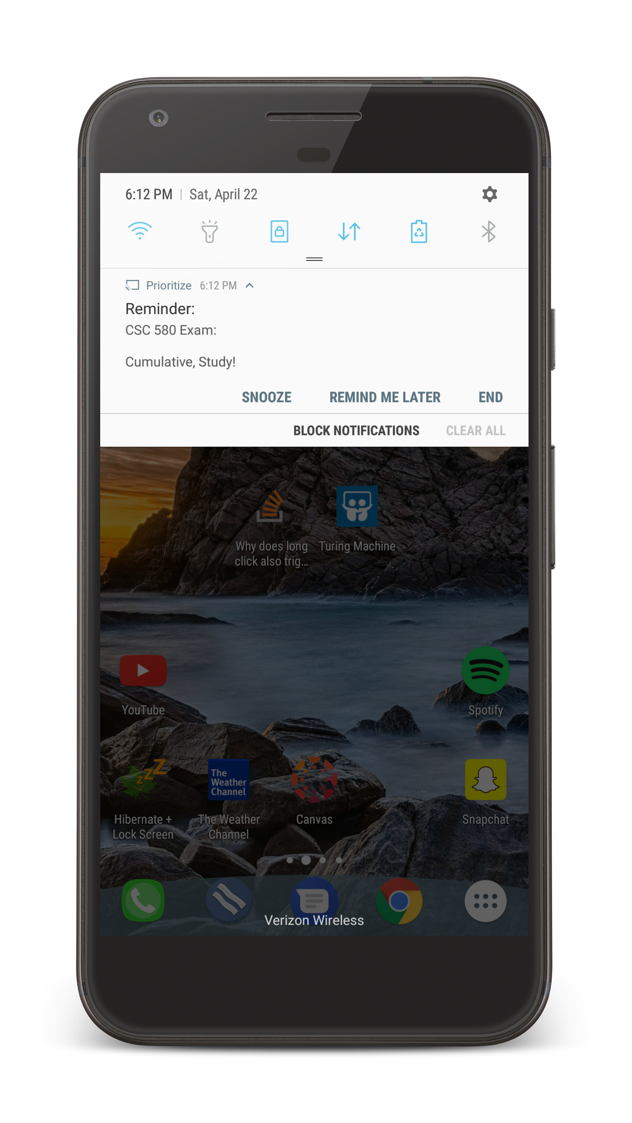
Notifications
Notifications have 3 options:
Snooze: Send another notification in 30 minutes.
Remind Me Later: Calculate a new alert time based on priority.
End Reminder: Cease alerts for this Reminder.
Android App
SQLite Database
UI
Notification
UI
JSON Parser
Reminder Creation / Priority Algorithm
SQLite Database
Priority Algorithm
JSON
Google Drive
Notification
JSON String

Slide 27
Syncing Across Devices
Opted for the Google Drive Android API.
Allows us to use the personal Drive space of Android users.
Available as a Google Play Service.

Slide 28
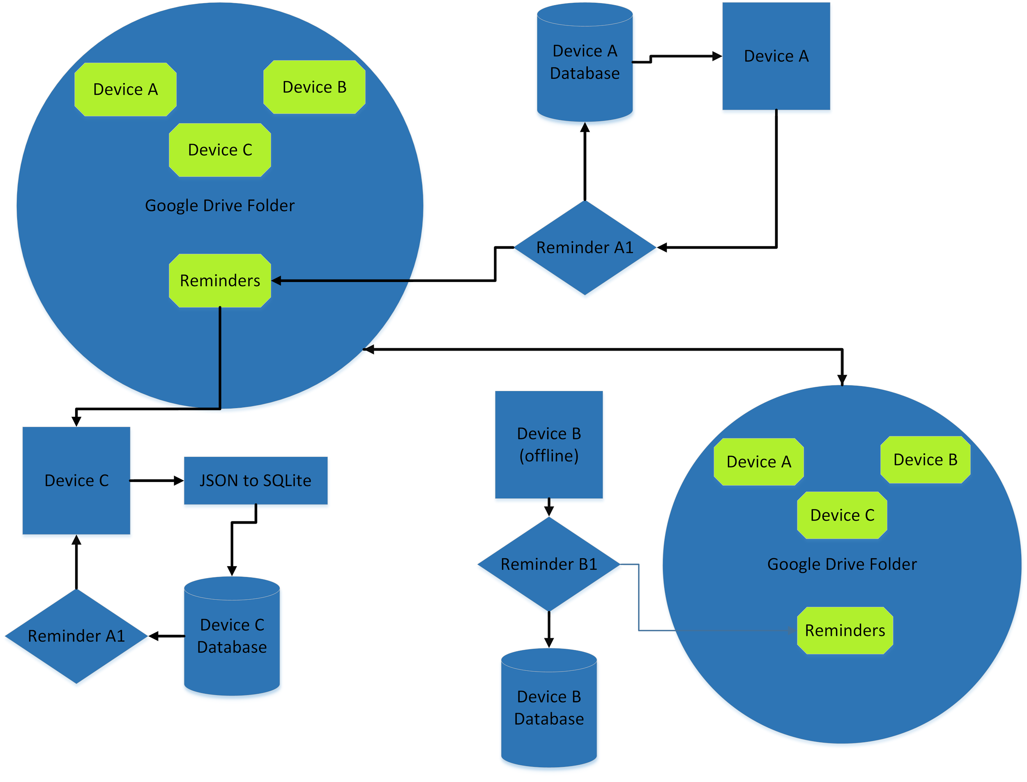

Slide 29
Demonstration

Slide 30
Future Plans for Improvement
Add a Geolocation / Geofencing Feature
Set alerts/reminders based on a particular location
Tidying up the UI
Add a timer / stopwatch feature

